Slide 1
Stealing our Children’s Youth
Michael Bailey

Slide 2
Who Dis?
Student, Currently Intern at The Crypsis Group
President of Mason CC, GMU’s (new) CTF club
CyberPatriot Nationals Team Captain, Club Pres of 80+
MDC3 HS & College Competitor
Participated in well over a dozen CTFs
20
Notes:
Worked for a defense contractor junior year HS after my mentor recruited me
Worked in IT after that for personal reasons
Worked at The Crypsis Group for over a year now
Marshall Academy club, 16 teams which means 80-96 members
I’m 20 so if you invite me to your happy hour I probably can’t come

Slide 3
Disclaimer
Nobody told me to do this
Nobody told me I could do this
Nobody even knew I was doing this
I’m representing nobody
Don’t be mean about anybody because I said things
Notes:
I’m not shilling for any particular talk
*Jericho @ Attrition

Slide 4
What’s this hootinanny about?
Cybersecurity activities primarily for high school to college You didn’t learn everything you did to get to this point in a public school classroom, so why would students today?
Notes:
Not to shit on schools or teachers

Slide 5
A few notes…
Maryland is killing it right now
Attack/defense more free range
Not operating off of a HS closed network
Less liability as assumed 18+
Notes:
UMD and UMBC shoutout, CJ gardner shoutout

Slide 6
Who cares?
HR People
Opportunistic people
Nice people
Young people
Curious people
Parents
CryptKids exists this year…
Notes:
For HR people, it’s their literal job
For opportunistic people, they’d want a hiring bonus
For nice people, perhaps you want to volunteer?
For young people, maybe they’re the actual participants?
Curious people may not actually be personally invested but might want to know about it all
Parents, while I’d never advocate you force them to be a hacker out of the womb or anything, may want to turn their kids onto some of these programs if possible

Slide 7
Background: Different Competitions
CTF: Capture the Flag
Jeopardy: You answer questions on forensic artifacts
Attack Defense: You pwn without getting pwned
Example: bsides.michaelbailey.co
CND: Computer Network Defense
You try not to get pwned
Some involve service uptime
Notes:
(Be brief, some people know this and some don’t)
CND means you can’t hack back which is much less fun but arguably more realistic

Slide 8
What makes a good comp/program?
Beginner friendly, but doesn’t waste advanced time
Requires you coordinate with another human
Does it teach AND test?
Stays on topic, isn’t a complete waste of time
Notes:
This is largely personal opinion
- Beginner friendly = maybe throw a few bones. Beginners get to try and advanced members get momentum if nothing else
Requires you coordinate = Soft skills are as important as hard skills, competitions with a team dynamic are substantially more useful, because IRL they’d get the work done but wouldn’t be able to talk to anyone
Stays on topic
IT competitions and Computer Science competitions are nice, but they’re just that
CyberPatriot and other CNDs struggle with this line, leans IT
Jeopardy CTFs frequently struggle with this line, leans CS
Attack/Defense are the “sexy” ones and sound like the answer, but how applicable is it
Okay, so testing yourself in competition is great and you can naturally work but obviously programs and events that help you learn, which may not even explicitly

Slide 9
Frequent Struggles
Too many rules/stipulations
Teamwork?
Only teaches subset of information
Will basically always be the case
Notes:
Bias: Got a CyberPatriot rules violation, but it won’t impact my judgement in any way
Some nonsense about “not publicly disclosing a live vulnerability” (sarcasm)
No but actually I’m not as shitty as I was in HS
CyberPatriot is anal about rules, likely rooted in their background of the AFA, so it’s ex-military running it
You can have people carrying your team in Jeopardy/point based competitions.
- CyberPatriot finals and true CNDs are not the case where you’re enforced to an SLA and the like
- Shane Wilton of Samurai cosigned this
Teaches subset
- CyberPatriot basically teaches IT
- Most jeopardy CTFs, esp for instance CSAW this year and backdoorCTF, focus heavily on pwning binaries and RE
- Maybe explain what “pwning” is in CTFs

Slide 10
Competitions
HS:
CyberPatriot
CyberMaryland MDC3
In Progress: VA Cyber Range
College:
CCDC
CyberLympics
In General:
Every CTF ever
Paid activities, company activities
Notes:
Shoutout to picoCTF for an obscene amount of gamification and production value

Slide 11
High School
Experience based out of Marshall HS

Slide 12
I Went Method
Credit: @GCMSTEMAcademy
Notes:
Went to Marshall HS for their CyberPatriot interest meeting to catch any updates, (deeply embedded myself in their elite operations sarcasm)

Slide 13
MDC3 @ CyberMaryland
Both professional and HS leagues
Previously: attack/defense live, buy-in, even sweeter prize
I have a rough history with this
Documented on Medium
After a year or two on ice, came back with a new host and entirely new format
Make your own assertions as you see fit
Notes:
Details are slim
Keeping my comments to medium
New description: This year's Cyber Challenge will be individual-based and utilize a time-trial format. Participants will have one-hour to solve as many cyber challenges as possible, ranging from defensive to offensive skills, and covering areas from Log Analysis to Live Exploitation.

Slide 14
VA Cyber Range
Really better for courses
Have it on reliable authority it’s in private beta for HS
In more public beta for colleges
SIFT VM in Browser
College faculty can opt in off the bat
So mostly of interest to literal teachers
Notes:
Opt-in VM provisioning is their real special sauce

Slide 15
CyberPatriot
Notes:
C.P. is a really unfortunate acronym to talk about when you’re in a high school
Who says you can’t get slides from your mother’s Facebook?
Does computer network defense, largely Windows and Linux, defined number of points which limits them
Attracted 105 people to an interest meeting in a HS, which is quite a few in HS terms
- institutional help helps promote it the most, but institutions are attracted to
Requires you somehow get your hands on laptops (we used our own)
YOU CAN COACH OR MENTOR

Slide 16
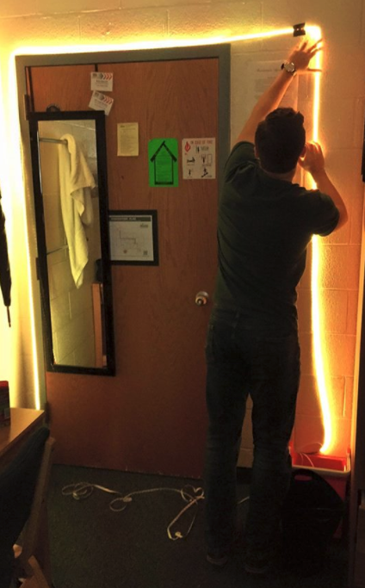
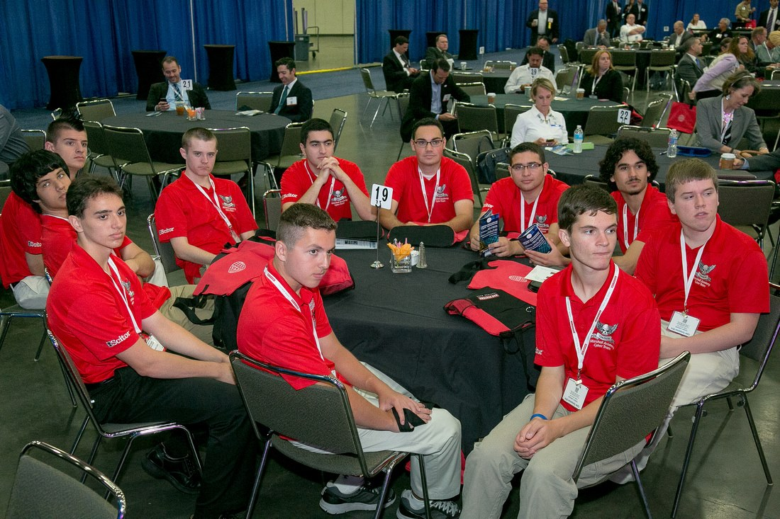
Actual Connections in Life
Notes:
Be brief, roommate/homeboy of 3 years after junior year HS we ran a cyberpatriot club together, now co-run the cybersecurity club at GMU

Slide 17
Already well integrated into Industry
Metier Defense then, Booz Allen now
Freelance iOS then, Crypsis Group now
Raytheon now
WaPo now
BoltMSP now
MITRE then and now
Metier Defense then, Crypsis Group now
Notes:
Pictured was the more straight-shooters in CyberPatriot back then
Northrop Grumman also specifically has a cyberpatriot pipeline internship
A lot of people who weren’t working weren’t because of actual reasons, such as religious reasons
A lot of these people just don’t have a large personal fingerprint
Also not pictured was CJ gardner

Slide 18
PicoCTF
A phenomenal example of where corporate funding could save something
Good college transition
Beginner friendly (less so recently, but still)
Story based (worse recently)
Notes:
They’re doing phenomenal currently, but where was the funding for picoCTF 2014 and picoCTF 2013?
HS friendly CTF, but similar to many professional or collegiate competitions
Despite itbeing harder andhaving a looser story it’s still one of if not the best

Slide 19
Notes:
PicoCTF 2017 interface
A ton of problems

Slide 20
Other CTFs in HS
Ironically both probably harder than picoCTF
Historically both computer science based
Still pretty fun

Slide 21
“How can I help?”
Be a coach or an advisor
Coach is more hands on
Host an event
CapitalOne literally had one in their SOC this week
Reach out to any participating county or school
Can likely hire from it
Can likely fund school
The fee itself isn’t usually a concern as much depending on the event
Notes:
The fee is steep, variable but in the hundreds generally per team, usually pretty easy for them to get funded from CyberPatriot or the county
For other competitions less so, like MDC3 at least used to be $250 straight up
Source: A struggling HS I mentored once (starts with an F, in Fairfax)

Slide 22
College
Experience based out of GMU
Notes:
I talk to people outside GMU, but a lot of my personal experience is out of GMU

Slide 23
CCDC
College version of CyberPatriot
Really fun, really limited
Virtual -> Regional -> National
Uses live red teaming more

Slide 24
Professional CTFs
You’re almost a professional already…
Very rarely does “Why not?” not apply
Networking if nothing else if in person

Slide 25
NCL
Key bit: They teach and test
though mostly not at the same time
Cyber Skyline: OS in the Browser
Does wonders for accessibility
Note unique for the region
Notes:
They have curriculum but not everyone uses it

Slide 26
Local Events
Metropolis
MDC3 (already mentioned)
VT Summit
NetWars sup? IoT village sup?
Local private invite events
Professional, HS and college events
A lot of research
Notes:
Metropolis takes HSs
Annapolis and HackEducate
IoT village is literally using CTFd iirc
The winner in the past two years I believe has been CJ, he’s literally a year older than me
Wave CJ

Slide 27
Host them!
Host local events!
Make them at least accessible to “growing individuals”
Insanely unique opportunity to showcase skills
and for companies to see potential candidates showcase skills
Notes:
There are so many professional groups and orgs with – for instance NovaHackers was talking about hosting one and I pray they do

Slide 28
ASK ME THINGS

